Slide 1
DBMS Ch:02 Entity Relationship Model

Slide 2
Outline
The entity relationship model
Entity types: Weak and strong entity
Entity Sets
Types of Attributes
Keys
Relationship Constraints: Cardinality and Participation
Extended Entity Relationship Model(EER):
Generalization, Specialization, Aggregation
‹#›

Slide 3
Building a database –Complex process
During Analysis and design a database designer needs to build a model of the proposed database design.
Architect build a model- Building
Aeronautical engineers- Aircraft
Computer Architecture- Model Computer
Traffic Engineer- Model Traffic

Slide 4
Model- Abstract representation of design.
Benefits of data modeling:
Focusing on essentials
Ease of Communication and Understanding
Product or process improvement

Slide 5
E R Model
ER model stands for an Entity-Relationship model.
It is a high-level data model.
This model is used to define the data elements and relationship for a specified system.
It develops a conceptual design for the database.
It also develops a very simple and easy to design view of data.

Slide 6



In 1976 Scientist Chas hen developed Entity-Relationship model.
ER diagram is having following components:
Entity
Attributes
Relationship

Slide 7



Features of ER model
Widely used technique
Easy to understand
Allows communication between end user and database designers

Slide 8






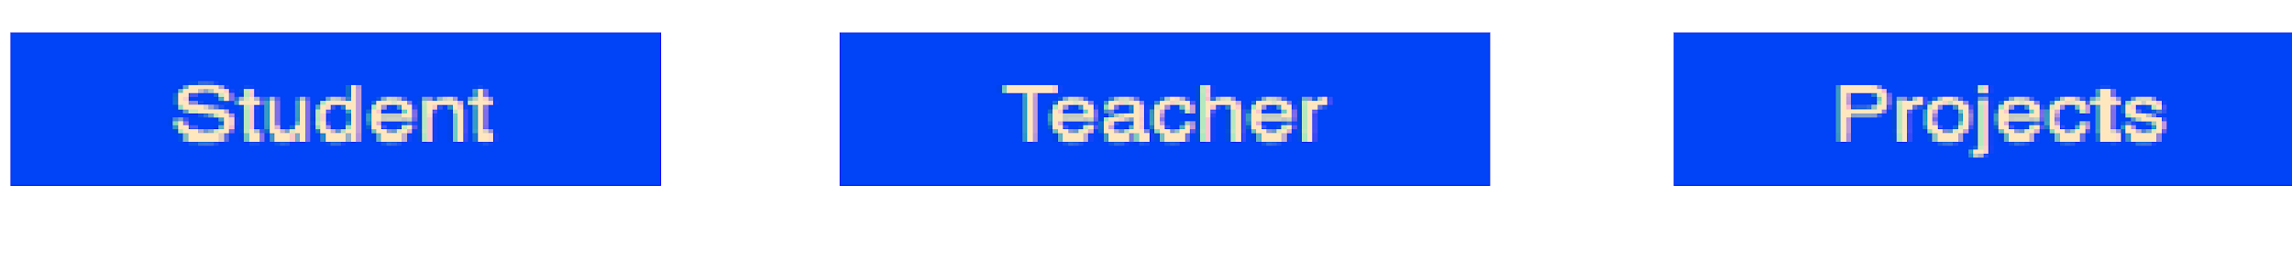


Entity
An entity can be a real-world object which may have physical or logical existence.
Eg: Student, , faculty,
Eg: Department , Section
Entities are represented by means of rectangles. Rectangles are named with the entity set they represent

Slide 9




Attribute
Properties of Entity
Presented by oval.
Simple Attribute
Composite Attribute
Single value Attribute
Multivalued Attribute
Derived attribute

Slide 10

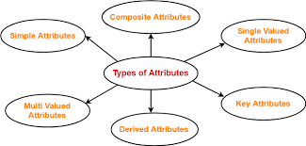




Slide 11

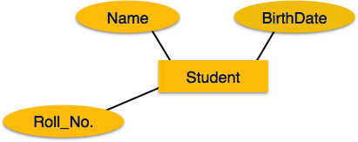


Simple Attribute

Slide 12


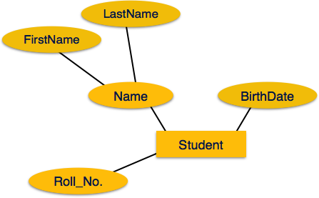



Composite Attribute

Slide 13
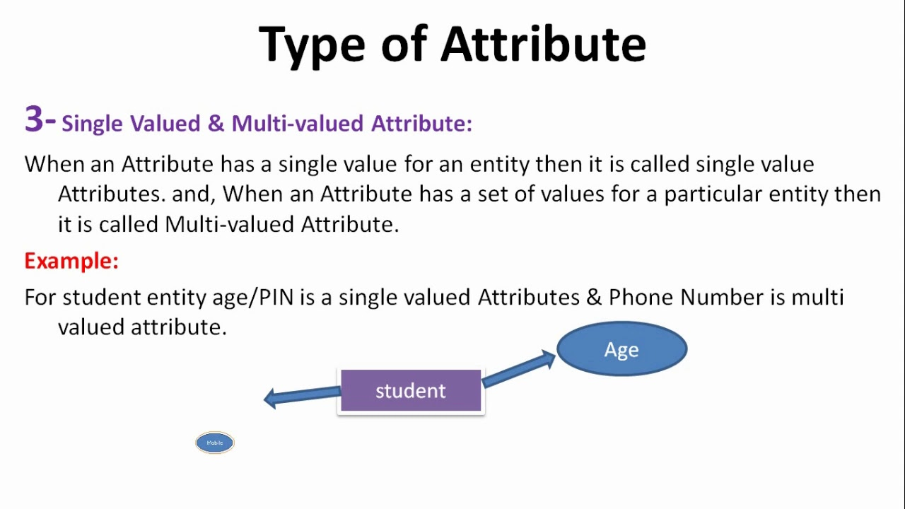

Slide 14
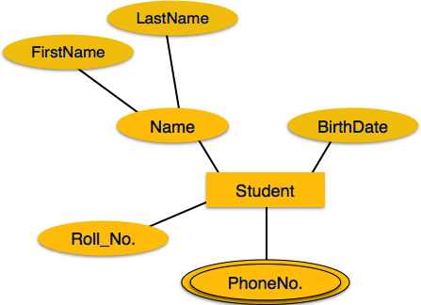

Multivalued Attribute

Slide 15
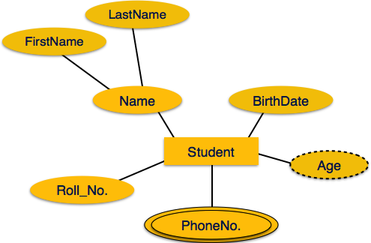



Derived Attribute

Slide 16


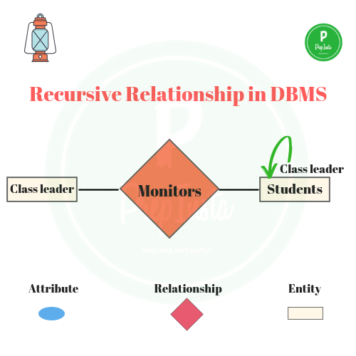












Relationship
Relationships are represented by diamond-shaped box. Name of the relationship is written inside the diamond-box. All the entities (rectangles) participating in a relationship, are connected to it by a line.

Slide 17






Mapping Cardinality
Number of entities from each side participating in a relation ship set.
One to one
One to many
Many to one
Many to many

Slide 18
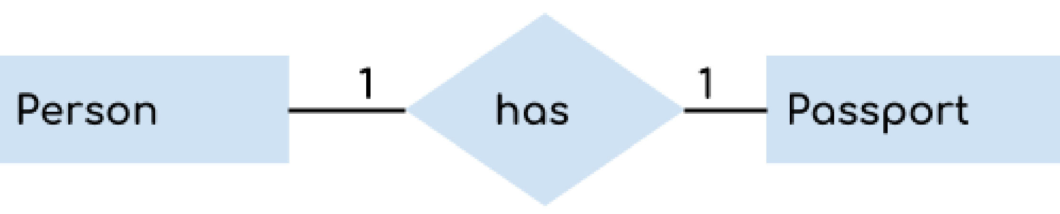






One to One Relationship
When a single instance of an entity is associated with a single instance of another entity then it is called one to one relationship.

Slide 19






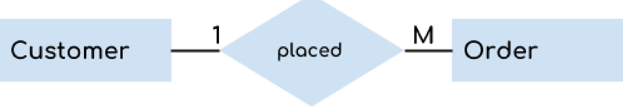




One to Many Relationship
When a single instance of an entity is associated with more than one instances of another entity then it is called one to many relationship.

Slide 20





Many to One Relationship
When more than one instances of an entity is associated with a single instance of another entity then it is called many to one relationship.

Slide 21




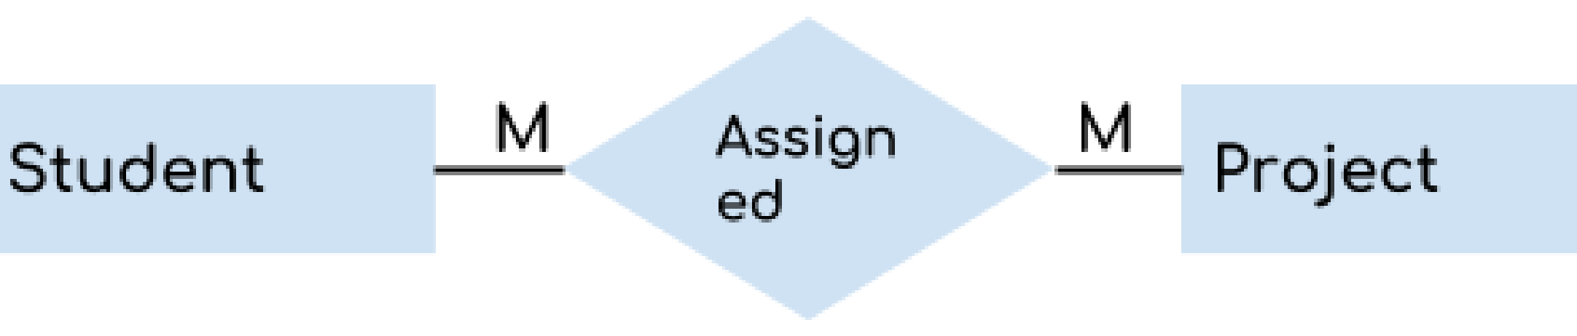






Many to Many Relationship
When more than one instances of an entity is associated with more than one instances of another entity then it is called many to many relationship.

Slide 22
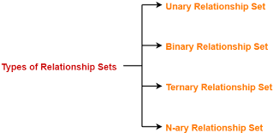
Degree of Relationship

Slide 23
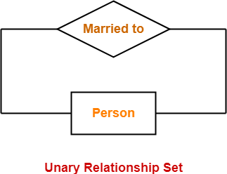
Unary relationship set
Unary relationship set is a relationship set where only one entity set participates in a relationship set.

Slide 24
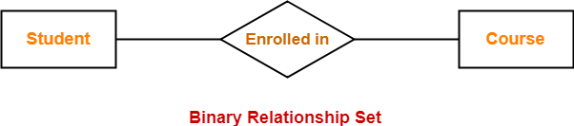
Binary relationship Set
Binary relationship set is a relationship set where two entity sets participate in a relationship set.

Slide 25
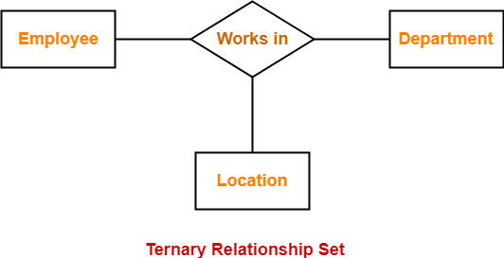
Ternary Relationship Set-
Ternary relationship set is a relationship set where three entity sets participate in a relationship set.

Slide 26
Participation Constraints Entity depend on relationship
Total Participation
Every object in an entity must participate in a relationship.
Indicated by dark line or double line.
Partial Participation
More than one object in an entity may participate in a relation.
Not all elements are involved.
By default participation.
Indicated by single line between entity and relation.

Slide 27
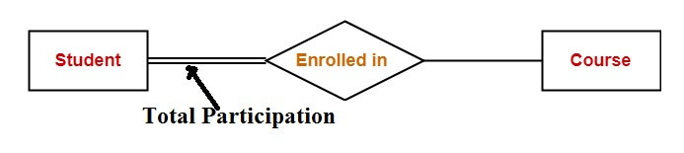
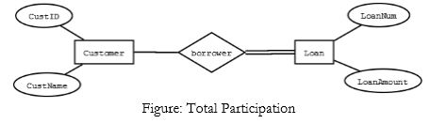
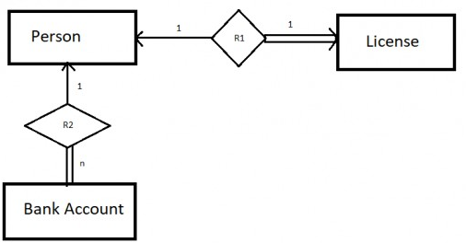
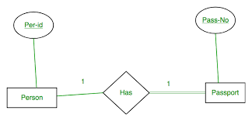
Total Participation

Slide 28
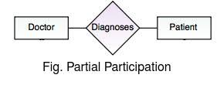
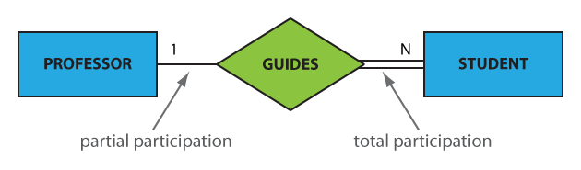
Partial Participation

Slide 29
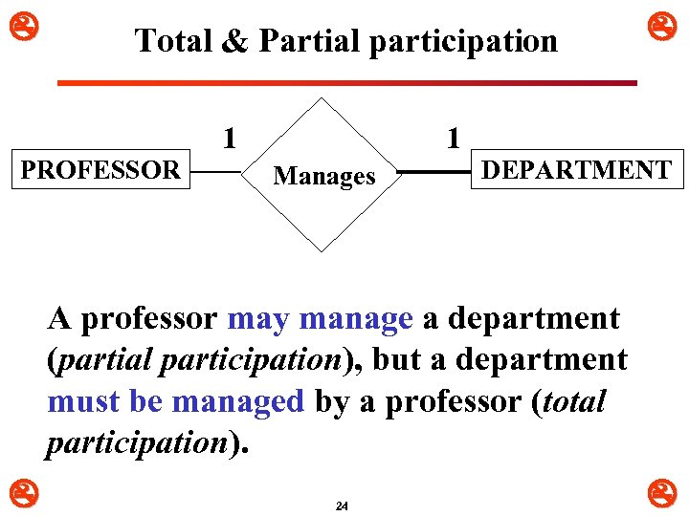

Slide 30
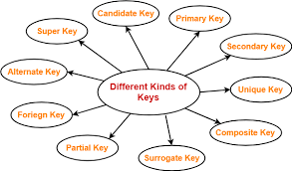
Keys

Slide 31
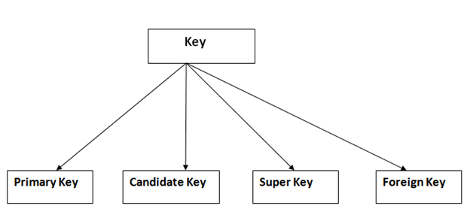
Important Keys

Slide 32
https://www.youtube.com/watch?v=JkwbhFUftSc

Slide 33
KEY
A DBMS key is an attribute or set of an attribute which helps you to identify a row(tuple) in a relation(table).
They allow you to find the relation between two tables.
Keys help you uniquely identify a row in a table by a combination of one or more columns in that table.

Slide 34
Super key
A super key is a group of single or multiple keys which identifies rows in a table.
A Super key may have additional attributes that are not needed for unique identification.
More than one super key
EmpSSN | EmpNum | Empname
9812345098 | AB05 | Shown
9876512345 | AB06 | Roslyn
199937890 | AB07 | James

Slide 35
PRIMARY KEY
PRIMARY KEY is a column or group of columns in a table that uniquely identify every row in that table.
The Primary Key can't be a duplicate meaning the same value can't appear more than once in the table.
A table cannot have more than one primary key.

Slide 36
Rules for defining Primary key:
Two rows can't have the same primary key value
It must for every row to have a primary key value.
The primary key field cannot be null.
The value in a primary key column can never be modified or updated if any foreign key refers to that primary key.

Slide 37
StudID | Roll No | First Name | LastName | Email
1 | 11 | Tom | Price | abc@gmail.com
2 | 12 | Nick | Wright | xyz@gmail.com
3 | 13 | Dana | Natan | mno@yahoo.com

Slide 38
ALTERNATE KEY
ALTERNATE KEYS is a column or group of columns in a table that uniquely identify every row in that table.
A table can have multiple choices for a primary key but only one can be set as the primary key.
All the keys which are not primary key are called an Alternate Key.

Slide 39
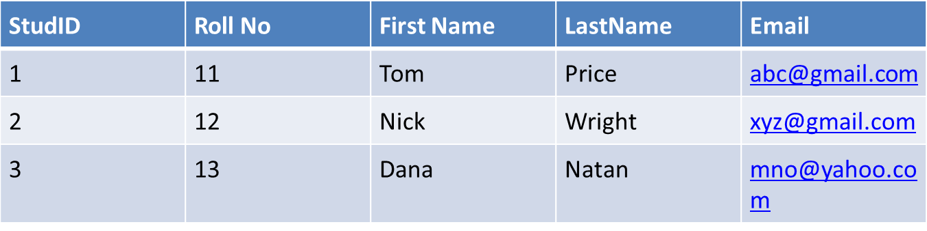
StudID, Roll No, Email are qualified to become a primary key. But since StudID is the primary key, Roll No, Email becomes the alternative key.

Slide 40
CANDIDATE KEY
CANDIDATE KEY is a set of attributes that uniquely identify tuples in a table.
Minimal set of Super key
The Primary key should be selected from the candidate keys.
Every table must have at least a single candidate key.
A table can have multiple candidate keys but only a single primary key.

Slide 41
Properties of Candidate key:
It must contain unique values
Candidate key may have multiple attributes
Must not contain null values
It should contain minimum fields to ensure uniqueness
Uniquely identify each record in a table

Slide 42
In the given table Stud ID, Roll No, and email are candidate keys which help us to uniquely identify the student record in the table.

Slide 43
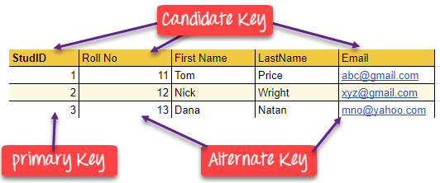

Slide 44
FOREIGN KEY
FOREIGN KEY is a column that creates a relationship between two tables.
The purpose of Foreign keys is to maintain data integrity and allow navigation between two different instances of an entity.
It acts as a cross-reference between two tables as it references the primary key of another table.

Slide 45
DeptCode | DeptName
001 | Science
002 | English
005 | Computer
Teacher ID | Fname | Lname
B002 | David | Warner
B017 | Sara | Joseph
B009 | Mike | Brunton
Teacher ID | DeptCode | Fname | Lname
B002 | 002 | David | Warner
B017 | 002 | Sara | Joseph
B009 | 001 | Mike | Brunton

Slide 46
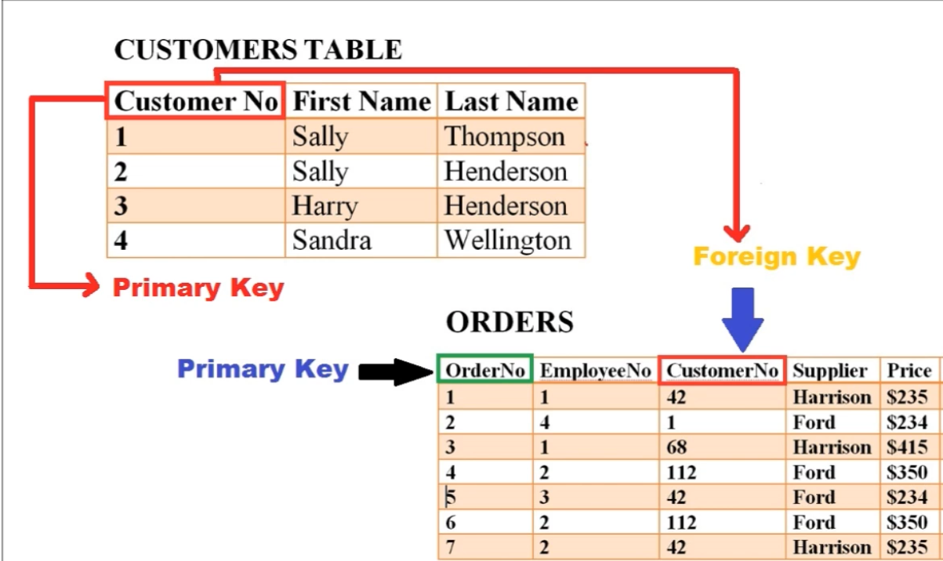

Slide 47
Primary Key | Foreign Key
Helps you to uniquely identify a record in the table. | It is a field in the table that is the primary key of another table.
Primary Key never accept null values. | A foreign key may accept multiple null values.
Primary key is a clustered index and data in the DBMS table are physically organized in the sequence of the clustered index. | A foreign key cannot automatically create an index, clustered or non-clustered. However, you can manually create an index on the foreign key.
You can have the single Primary key in a table. | You can have multiple foreign keys in a table.

Slide 48
Compound key
COMPOUND KEY has two or more attributes that allow you to uniquely recognize a specific record.
It is possible that each column may not be unique by itself within the database.
However, when combined with the other column or columns the combination of composite keys become unique.
The purpose of compound key is to uniquely identify each record in the table.

Slide 49
OrderNo | PorductID | Product Name | Quantity
B005 | JAP102459 | Mouse | 5
B005 | DKT321573 | USB | 10
B005 | OMG446789 | LCD Monitor | 20
B004 | DKT321573 | USB | 15
B002 | OMG446789 | Laser Printer | 3
OrderNo and ProductID can't be a primary key as it does not uniquely identify a record. However, a compound key of Order ID and Product ID could be used as it uniquely identified each record.

Slide 50
Surrogate key
An artificial key which aims to uniquely identify each record is called a surrogate key.
These kind of keys are unique because they are created when you don't have any natural primary key.
They do not lead any meaning to the data in the table. Surrogate key is usually an integer.

Slide 51
Fname | Lastname | Start Time | End Time
Anne | Smith | 09:00 | 18:00
Jack | Francis | 08:00 | 17:00
Anna | McLean | 11:00 | 20:00
Shown | Willam | 14:00 | 23:00
Surrogate keys are allowed when No property has the parameter of the primary key.
In the table when the primary key is too big or complicated.

Slide 52
student_id | name | phone | age
1 | Akon | 9876723452 | 17
2 | Akon | 9991165674 | 19
3 | Bkon | 7898756543 | 18
4 | Ckon | 8987867898 | 19
5 | Dkon | 9990080080 | 17

Slide 53
Entity Set
Collection of entities of same type.
Student entity set- All students in College database
Entity Type
Strong Entity type
Weak Entity Type

Slide 54


Strong Entity
A strong entity is not dependent of any other entity in the schema.
A strong entity will always have a primary key.
Strong entities are represented by a single rectangle.
The relationship of two strong entities is represented by a single diamond.
Various strong entities, when combined together, create a strong entity set.

Slide 55




Weak Entity
A weak entity is dependent on a strong entity to ensure the its existence.
Unlike a strong entity, a weak entity does not have any primary key.
It instead has a partial discriminator key. A weak entity is represented by a double rectangle.
The relation between one strong and one weak entity is represented by a double diamond.

Slide 56
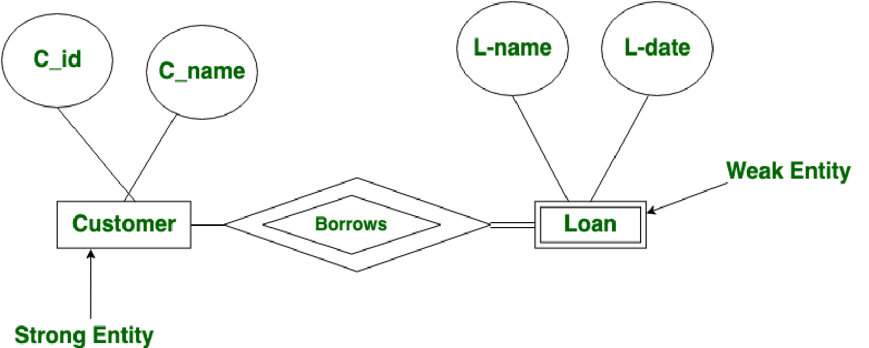




Slide 57
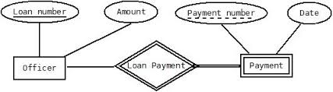




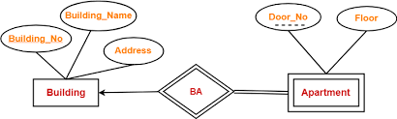


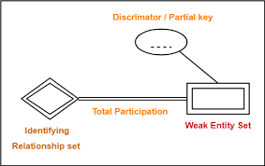





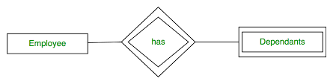

Slide 58







Difference between Strong and Weak Entity
S.NO | STRONG ENTITY | WEAK ENTITY
1. | Strong entity always has primary key. | While weak entity has partial discriminator key.
2. | Strong entity is not dependent of any other entity. | Weak entity is depend on strong entity.
3. | Strong entity is represented by single rectangle. | Weak entity is represented by double rectangle.
4. | Two strong entity’s relationship is represented by single diamond. | While the relation between one strong and one weak entity is represented by double diamond.
5. | Strong entity have either total participation or not. | While weak entity always has total participation.

Slide 59
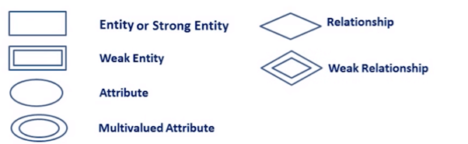

Slide 60
Thank you !
‹#›

